Slide 1

MARKETING WEB ANALYTICS PROJECT
GROUP 4
Adityan
Neetesh
Oluwatomilola
Siddarth
Siddharth
Varun
Rajendran
Hegde
Aluko
Sheshagiri
Govindarajan
Muralidharan

Slide 2


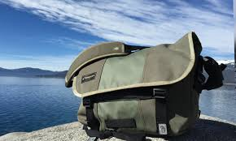
CONTENTS
About Timbuk2
Business Objectives and KPIs
Data Analysis & Insights
Recommendations

Slide 3
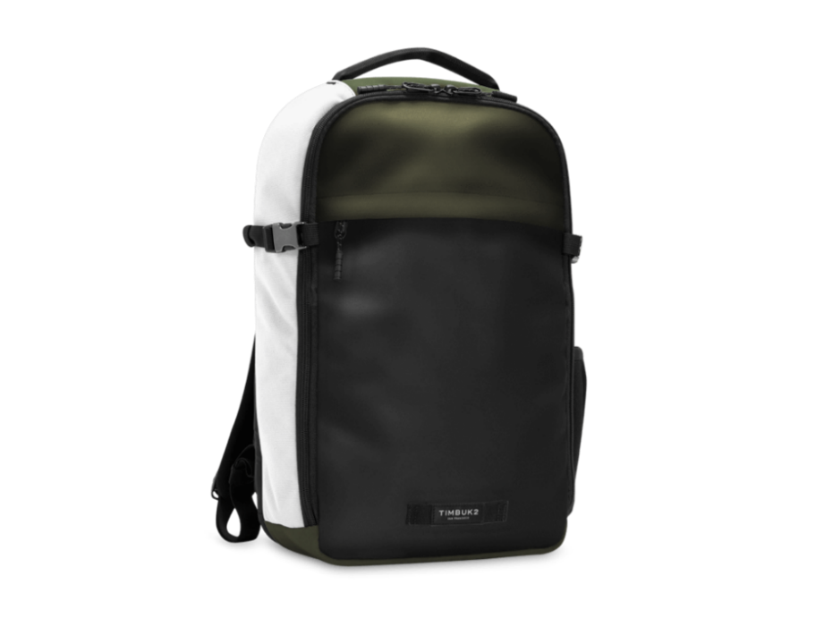

About Timbuk2
Timbuk2 is an American bag manufacturer and marketer
The company produces a variety of pre-made and made-to-order bags
Timbuk2 is owned by private equity group TB2 Investors
Timbuk2 has retail stores in San Francisco, Seattle, Chicago, Denver, Los Angeles and New York
Timbuk2 was founded in 1989 by bike messenger Rob Honeycutt who believed in Toyota’s "just in time" manufacturing model
The company collaborated with New Balance to release specially branded products

Slide 4



Business Objectives & KPIs
Business Objectives | KPIs
Convert Visitors to Customers Likeliness of audience visiting our website becoming our customer | Conversion Rate Orders/Visits
Increase Revenue per Transaction Help make key business decisions and leverage every opportunity to make a higher revenue | Average Order Value Revenue/Orders
Customer Retention & Customer Loyalty Understand the purchasing habits of customers | Unique Purchases Total number of times a product is part of a transaction
Notes:
We can trim down business objectives to be included in the speech. Only words in brackets can be used as business objectives.

Slide 5
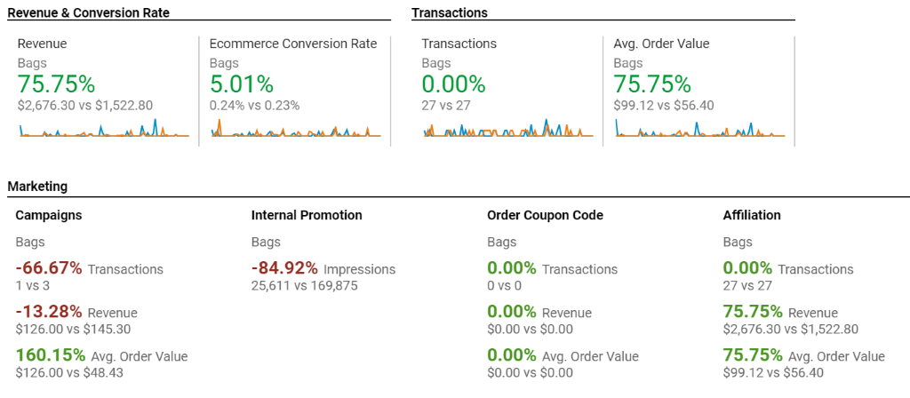
General overview and comparison between Q4 2019 and Q1 2020

Slide 6
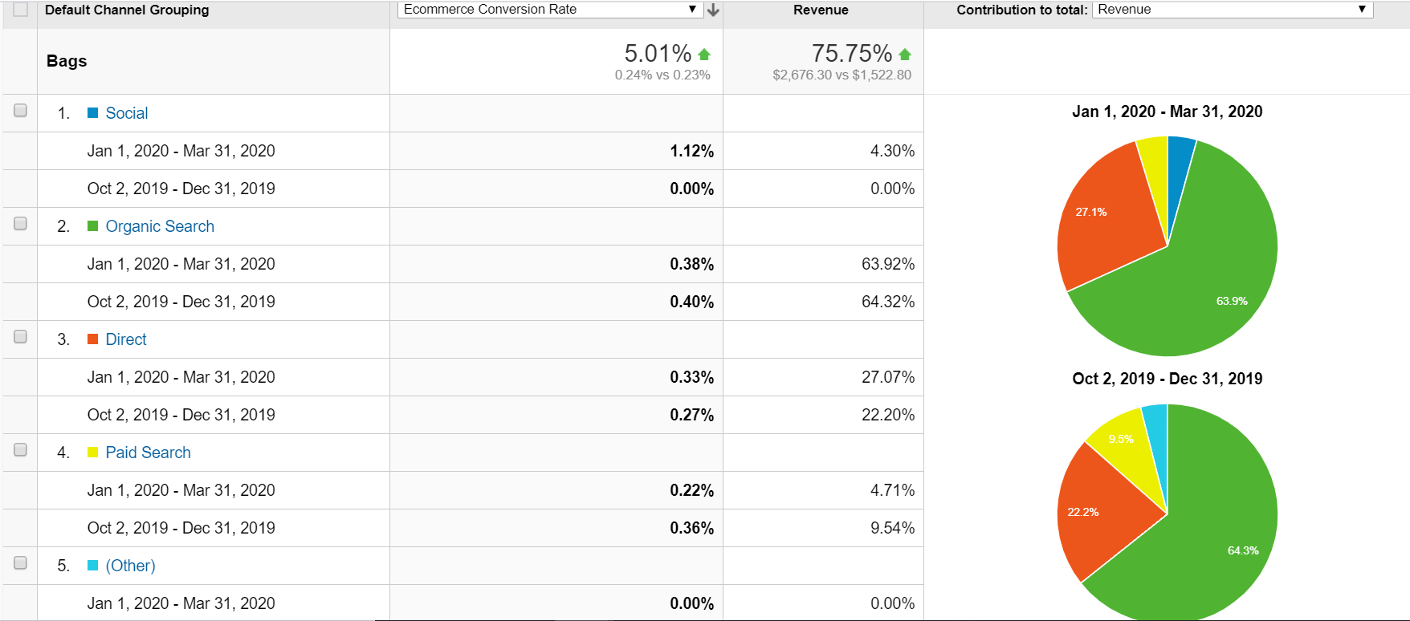
Marketing Channels performance impact in Q4 2019 and Q1 2020

Slide 7
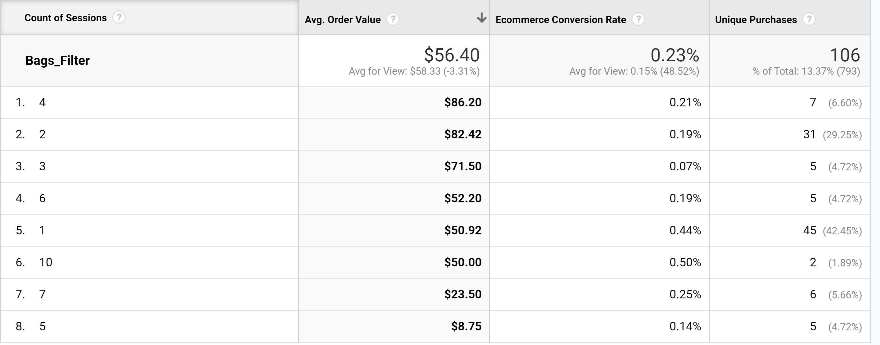
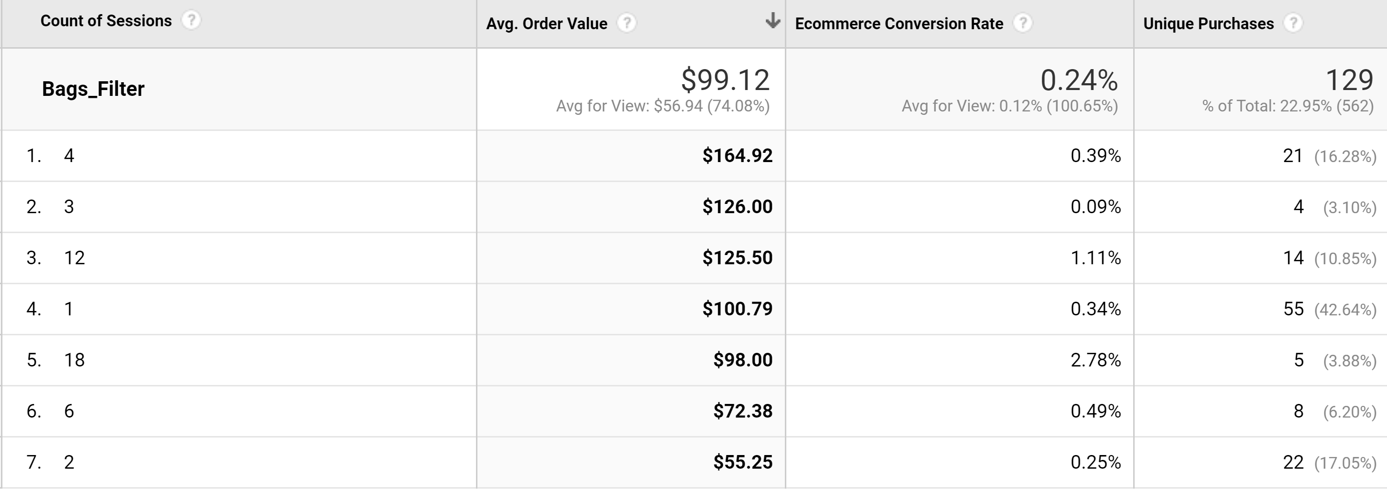
Analysis of visit number on Success Metrics in Q4 2019 and Q1 2020
Q4 2019
Q1 2020

Slide 8
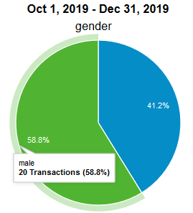
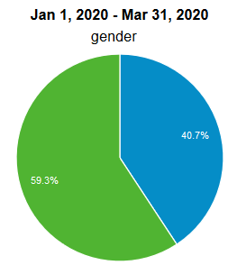
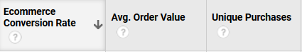
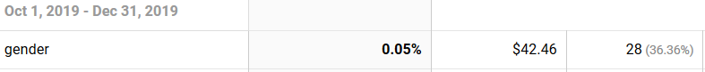
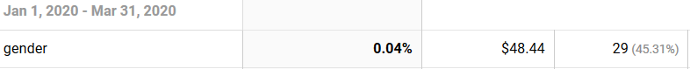
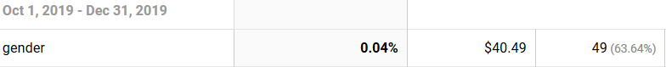
Customer profile Analysis (Gender) for Q4 2019 and Q1 2020
Notes:
In order to understand the customers of timb we devided to prfom analys using age and gender. From our analysis
We found that females tended to have a higher avov In q1 of 202, there was a remarkable increase in aov. Also females saw an increase in unique purchases in q1. Howve, there was a slight decrease in conv rate from 0.5 to 0.4
For males we found that, conversion rate was same for both quarters, however, there was an increase in aov from we noticed that there was a decrease in the no of unique purchases in q1.

Slide 9
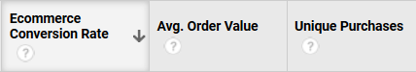
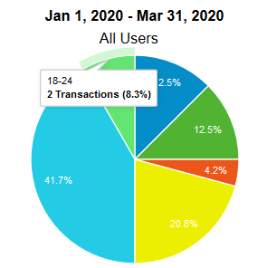
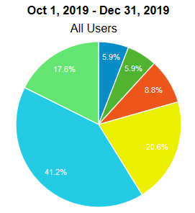
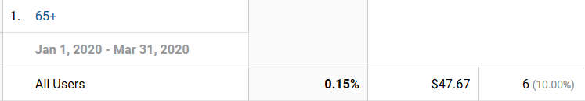
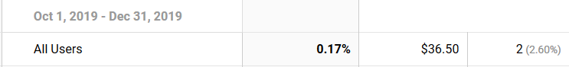
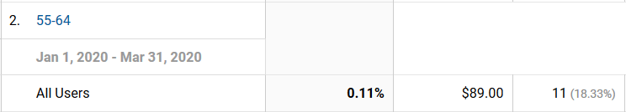
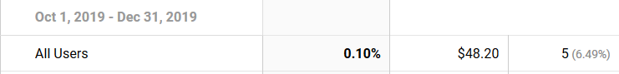
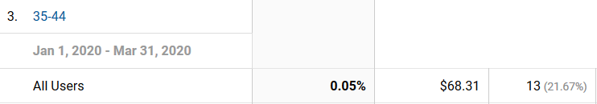
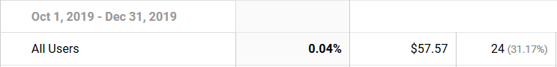
Customer Profile Analysis (Age) for Q4 2019 and Q1 2020
Notes:
We performed Age analysis on our customers from Q4 &Q1.
WE FOUND THAT 3 MAJOR AGE GRPS 65+ 55-64,& 35-44 were important
to our KPIS.
From analysis, we gathered that Conv rate was generally higher
amongst the 65+ range though it dropped in Q1
This could be due to the fact that there's a holiday season in Q4
Analysis should be done to further understand why
Wea also found dt in Q1, PEOPLE IN 55-64 HAD THE AVERAGE ORDER
VALUE WHIL. IN THE PREV QUART HOWEVWR PEIPL AGD 35-45 HAD THE
HIGHEST AOV
For unique purchases, genefrally, ppl aged 35-44 had a higher number,
hower unique purchases dropped from 24 to 13 in q1

Slide 10
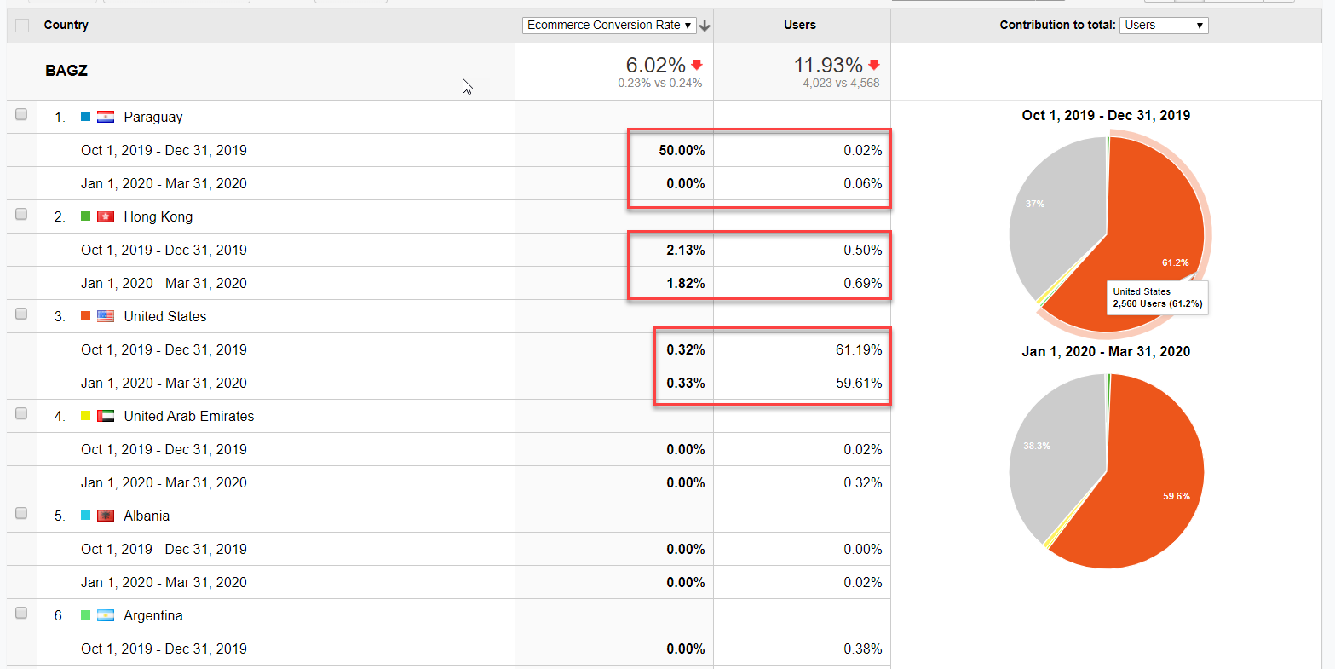
Conversion Rate: Country analysis for Q4 2019 and Q1 2020
Paraguay has the highest conversion rate for Q4​
Hong Kong has the highest conversion rate for Q1​
Paraguay's conversion rate dropped drastically in Q1​
Notes:
After conducting customer profile analysis using age and gender, we wanted a broader view on our conversion rate. We decided to find out what countries and contributed to conv rate. We found 3 countries to be particularly interesting Paraguay, HOKO AND US
· In Q4, Paraguay has the highest conversion rate though it has a very low % users . While the US has a large % of users, it’s conversion rate is relatively low
· In Q1, US still has the most users, but with a low conversion rate, it dropped from the 3rd highest conversion rate to the 5th position. Paraguay is also no longer in the top 10 countries contributing to cr . Hong Kong, which in the prev quart had the 2nd highest conversion rate is now the 1st.

Slide 11
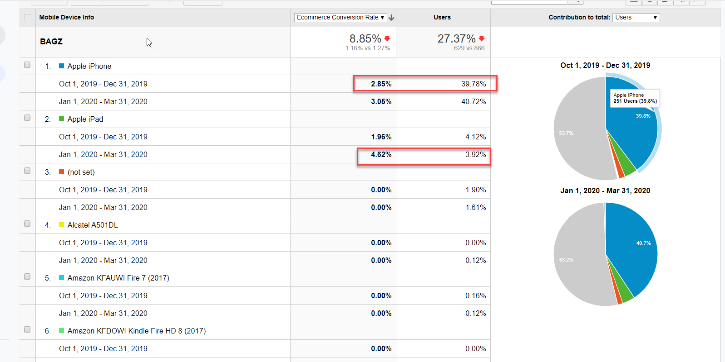
Conversion Rate: Device type analysis for Q4 2019 and Q1 2020
Notes:
or Q4, majority (39.78%) of users to Timbuktu came from the iPhone and iPhone also had the highest conversion rate.
· For Q1, while majority (40%) of users still used an iPhone, most conversion came from the iPad

Slide 12
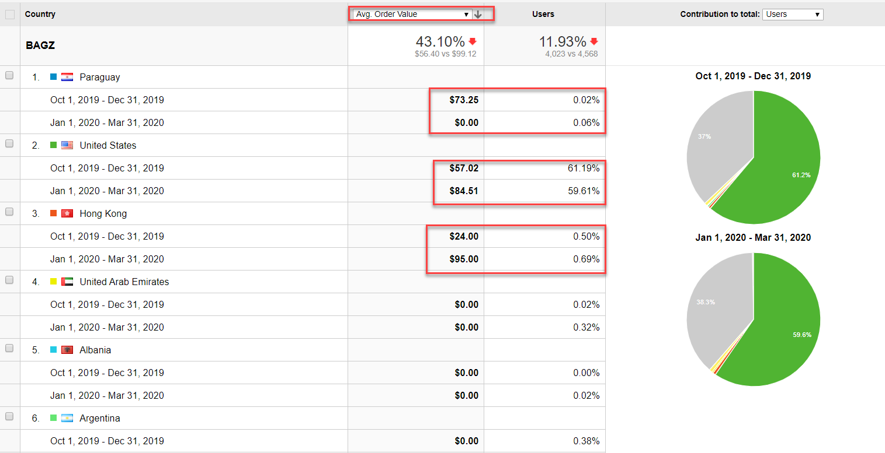
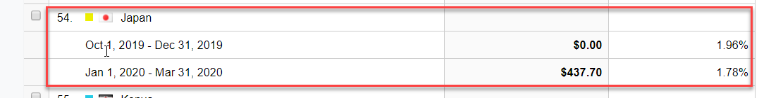
AOV: Country Analysis for Q4 2019 and Q1 2020
Paraguay had the highest AOV in Q4​
Paraguay's AOV dropped drastically in Q1​
AOV increased by 5 folds in Q1​
Japan had the highest AOV in Q1
Notes:
In Q4, Paraguay had the highest order value even though US has more users.
· In Q1, the average order value increased from 73 dollars to 437. Japan now has the highest order value, it wasn’t in the top 10 countries in the previous quarter. Timbuktu probably initiated or increased marketing campaigns. The US still has the highest number of users.

Slide 13
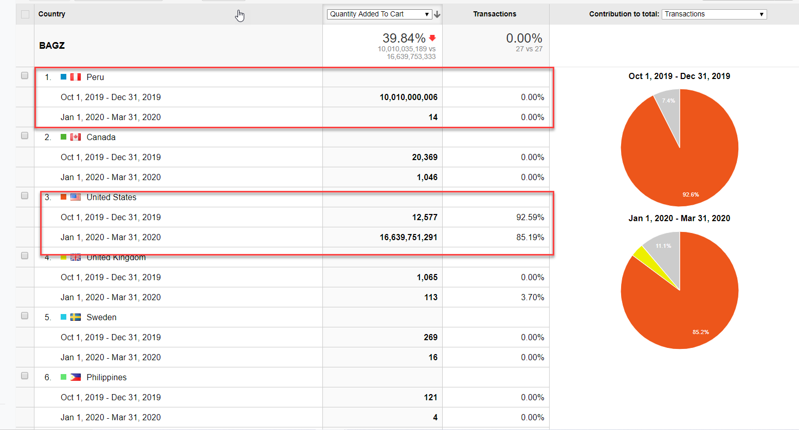
Shopping Cart Analysis for Q4 2019 and Q1 2020 (Quantity added)
Notes:
n Q4,The highest qtty added to cart is in Peru, this however leads to no transactions. The US had the highest qqty added to carts that led to transactions
The trend turned in Q1, with the highest number of cart additions occuring in the US as well as transactions.
In both years, the US had both the highest removals and transactions

Slide 14
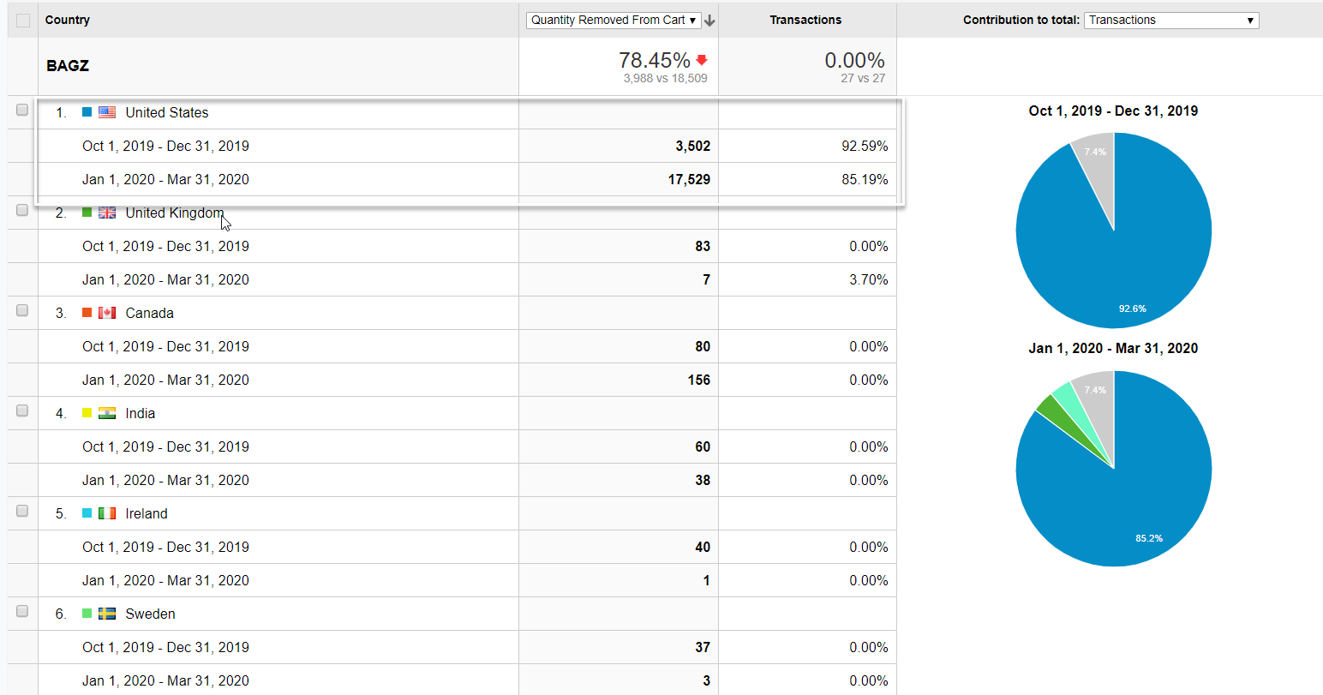
Shopping Cart Analysis for Q4 2019 and Q1 2020 (Quantity removed)
Notes:
In both years, the US had both the highest removals and transactions

Slide 15
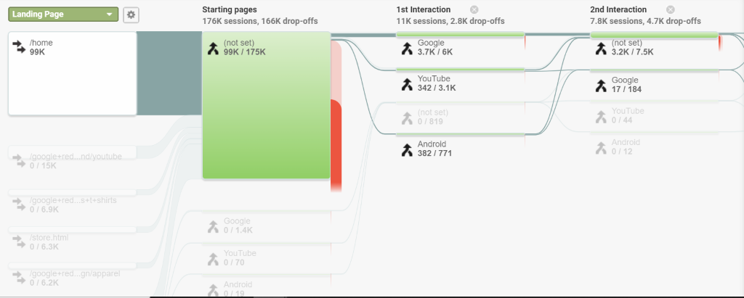
Page Flow Analysis for Q1 2020

Slide 16
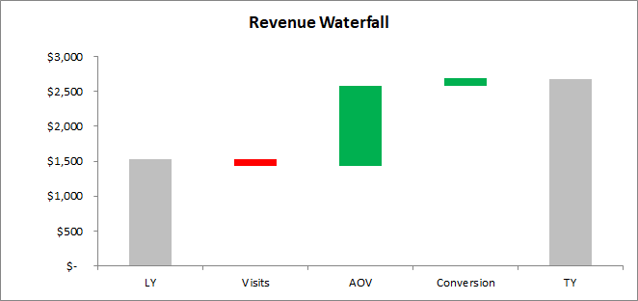
Waterfall Analysis for Q4 2019 Vs Q1 2020
Visits (6%)
Conversion 6%
AOV 76%

Slide 17
Recommendations
Sell More and Expand Business
Optimize website for mobile devices with low screen resolution (Especially Apple)
Increase visibility, brand awareness by investing in advertisements in Hong Kong, Japan, UK as this countries have high conversion rates and average order values.
Evaluate product pricing plans for UK customers. Competitor analysis is strongly suggested for US and UK
Provide discounts, promotional offers for US & Peru customers to reduce cart abandonment
Notes:
Sell more and expand business – increase AOV
Convert visitors to customers - increase conversion

Slide 18
Recommendations
Convert Visitors to Customers
Improvise CTR by better designs for site navigation (Affiliates) and targeted A/B testing using loyal customer base
Research on latest trends for internal promotions and decide on target customers for these promotions based on revised customer segmentation
Increase investment for re-marketing Campaigns (email reminders, browser/in-app notifications, display Ads) and target customers who have previously added products to cart. This has strong potential to improve our returns
Notes:
Sell more and expand business – increase AOV
Convert visitors to customers - increase conversion

Slide 19
Recommendations
Customer Retention & Customer Loyalty
Targeted promotions and exclusive collections for 18-24 & 45-54 age groups
Tailored cost-effective selections can be suggested for 65+ age groups
Invest in flagship (luxury) and festive product design for males and aggressive marketing before holiday season
Notes:
Sell more and expand business – increase AOV
Convert visitors to customers - increase conversion

Slide 20
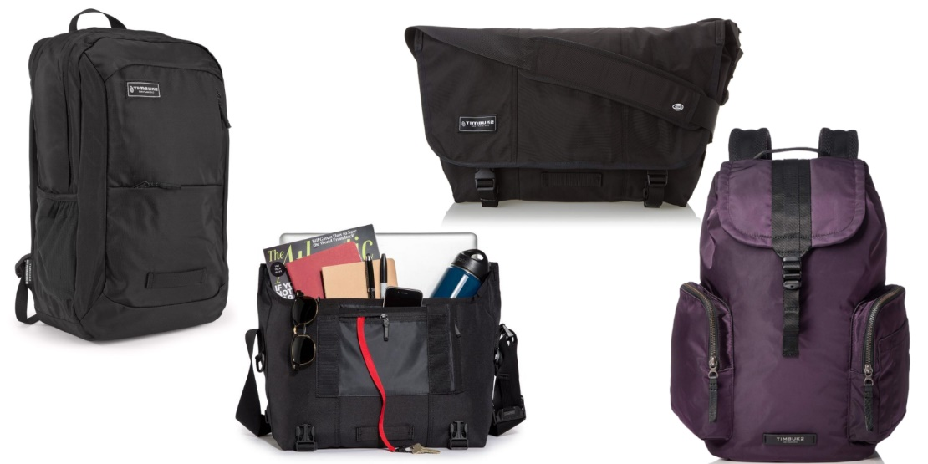
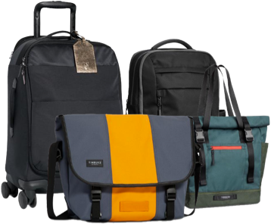
THANK
YOU

